Slide 1


11/06/2024
OER-conference Tübingen
Herzlich
Willkommen
Bienvenue
Welcome
@

Slide 2
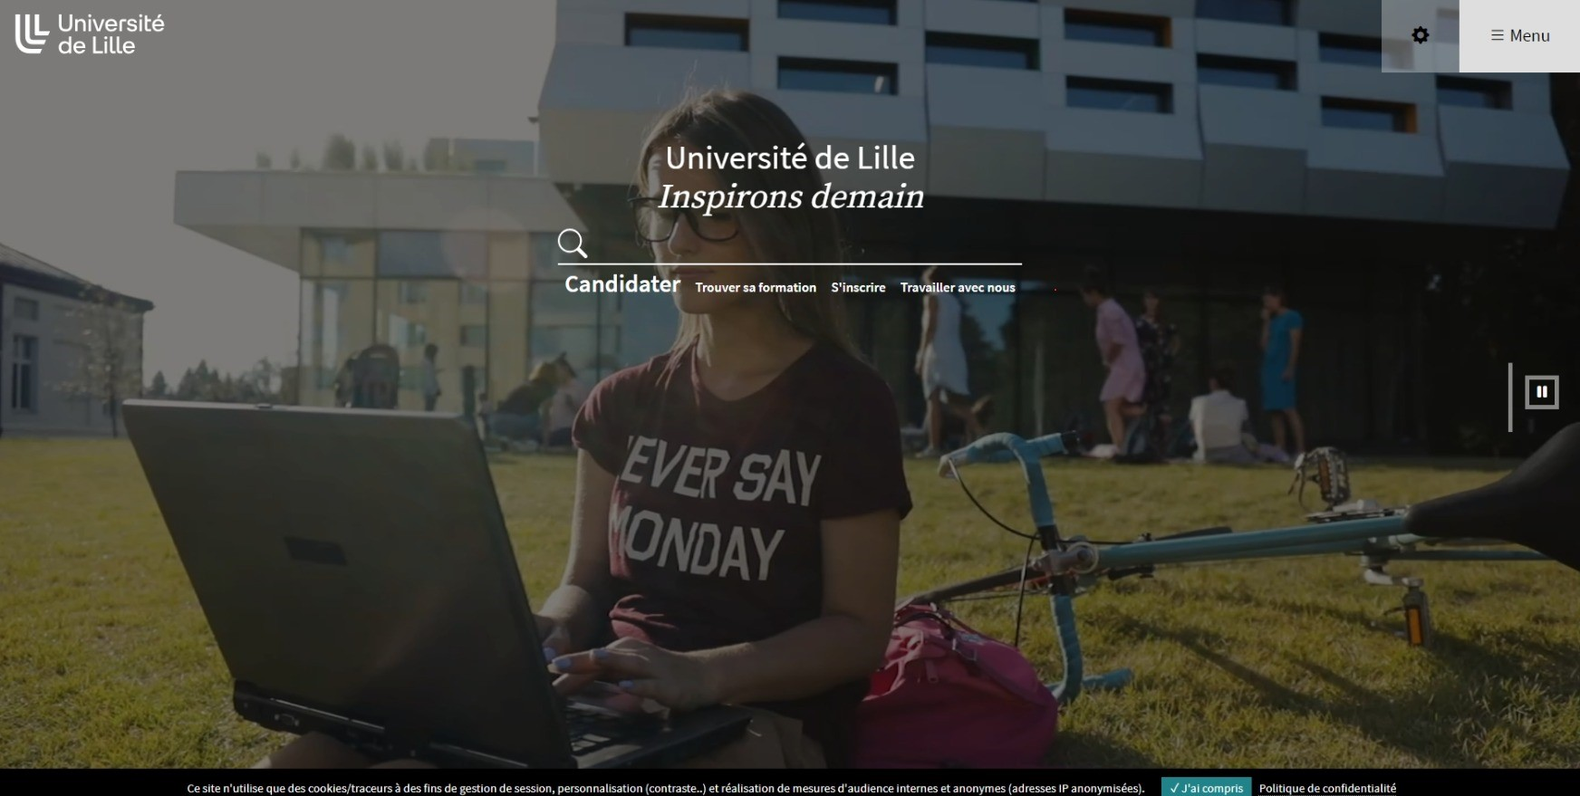
Open Education & Digital Identity, University of Lille

Slide 3

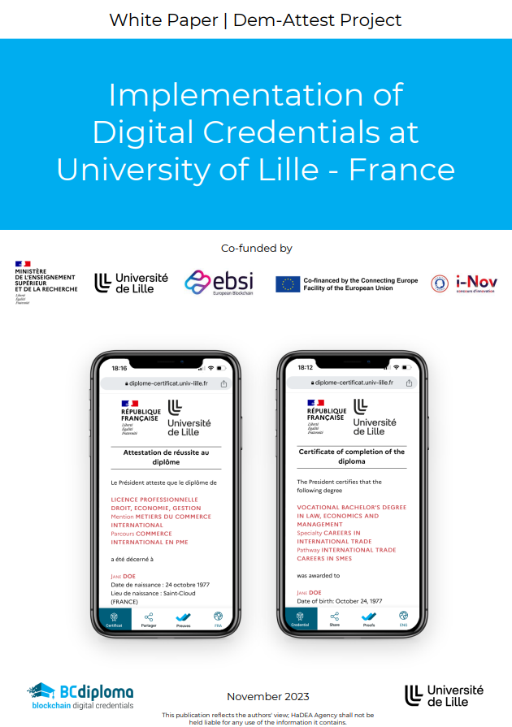
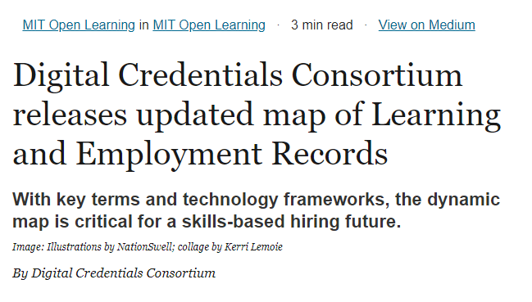

Slide 4

oeg.francophone@gmail.com

Slide 5

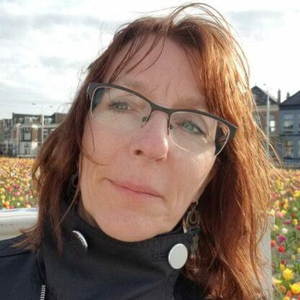
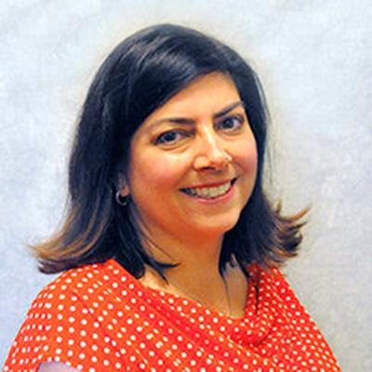
OEG Board Leadership
Perrine de Coëtlogon
Constance
Blomgren
Lisa Young
President of the Board
2023-2025
Vice President of the Board
2023 -2025
Vice President of the Board
2023 -2025
University of Lille | France
Athabasca University | Canada
Maricopa County Community College District | United States of America

Slide 6
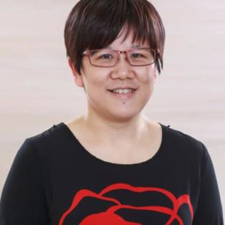
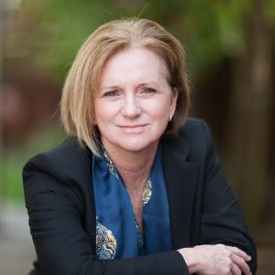
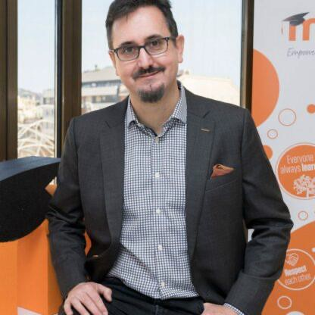
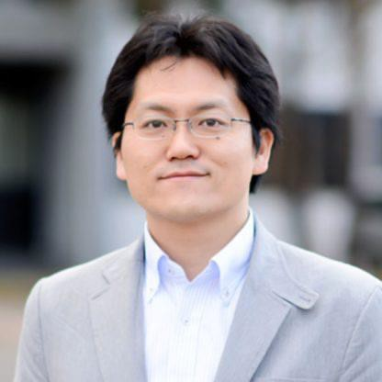
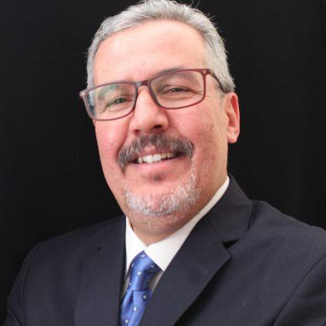


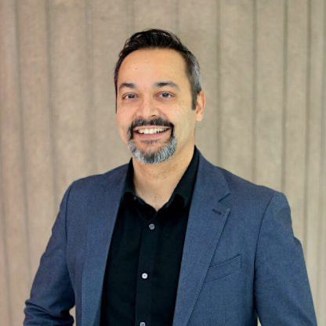
OEG Board of Directors
Hsu-Tien (Marian) Wan
Treasurer
Taipei Medical University |
Taiwan
Catherine M. Casserly Casserly Consulting & Coaching | United States
Martin Dougiamas
Moodle | Australia
Katsusuke Shigeta
Hokkaido University | Japan
Noureddine Zemmouri Université de Biskra | Algeria
María Soledad Ramírez Montoya (Marisol) Tecnológico de Monterrey Mexico
Paola Corti
Politecnico di Milano | Italy
Rajiv Jhangiani
Brock University | Canada

Slide 7
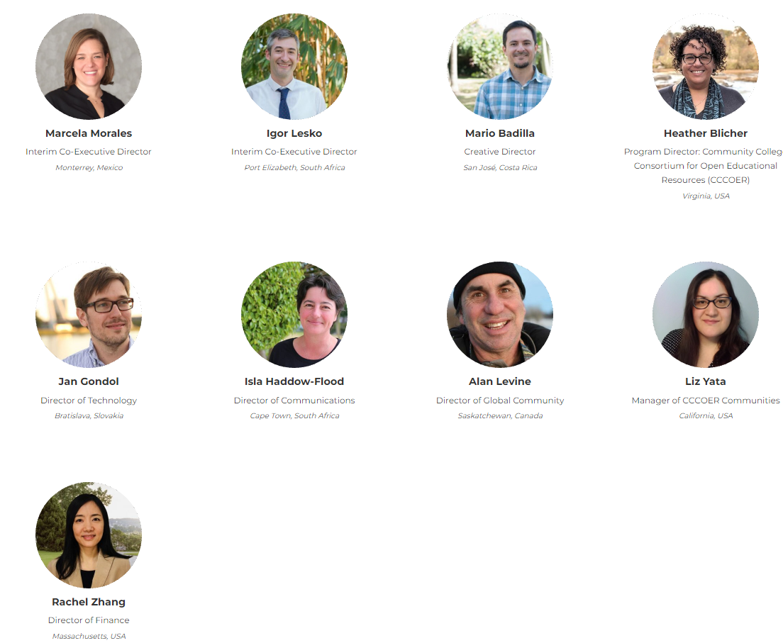
OE Global Team

Slide 8

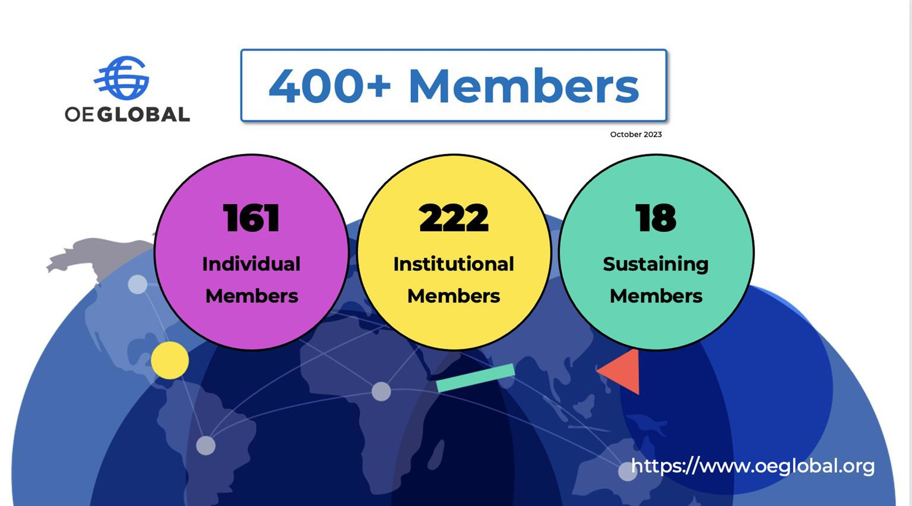

Slide 9


Field Building
gather • collaborate • support • share
https://conference.oeglobal.org/
https://oeweek.oeglobal.org/

Slide 10
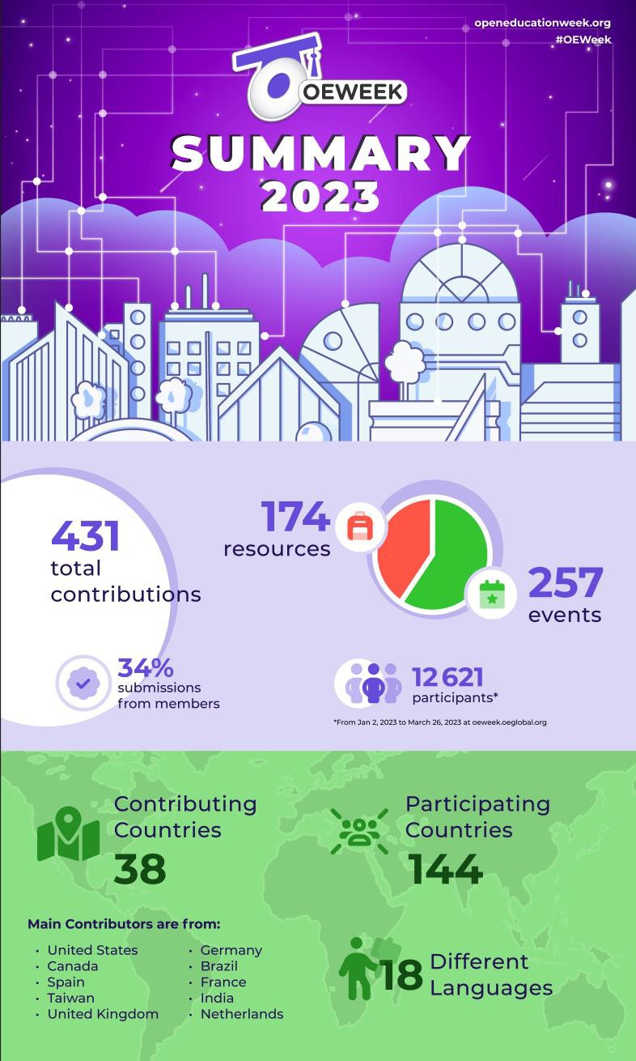

Since 2012 OE Week has hosted 2,064 events in 38 languages and gathered 85,535 participants from 192 countries.
Mark your calendars!
March 4-8, 2024

Slide 11

Celebrate! June 30 2024
OEGlobal recognizes each year since 2011
recipients of the Open Education Awards
for Excellence (OEAwards), whose work reflects the outstanding achievements and shared wealth of the open education community.
16 awards granted in 2023
237 total awards since 2011
https://awards.oeglobal.org/

Slide 12



Foster knowledge exchange
OEG Connect
OEG Voices
OEG Live
Space for the global open education community to chat, share, collaborate, and navigate the many and varied subjects related to Open Education.
A podcast that shares conversations with open educators, innovators and leaders from around the world discussing their work and solutions.
Regular series of candid, open conversations with Alan Levine.

Slide 13


Regional Communities
https://www.oelatam.org/
https://www.cccoer.org/
The Open Education Latin America Regional Node (OE LATAM) is a community driven network that works cooperatively to establish, coordinate, and sustain a regional ecosystem that further enhances the development of open education initiatives and practices in the region.
The Community College Consortium for Open Educational Resources (CCCOER) is an OE Global regional node primarily focused on supporting the adoption and use of open educational policies, practices, and resources by community colleges across the USA and Canada.
+ Francophone regional community building in OEG Connect.

Slide 14


Slide 15
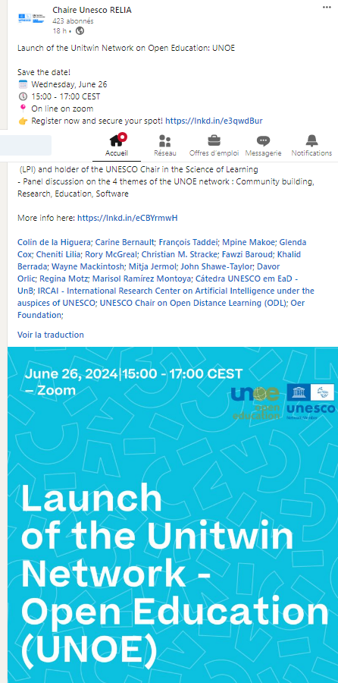
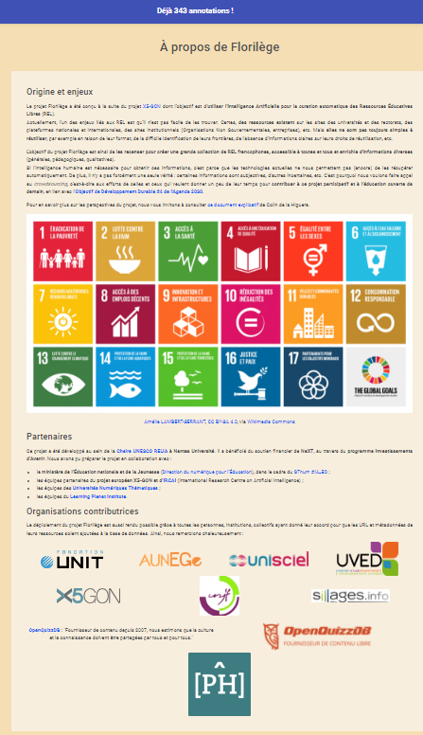



Slide 16
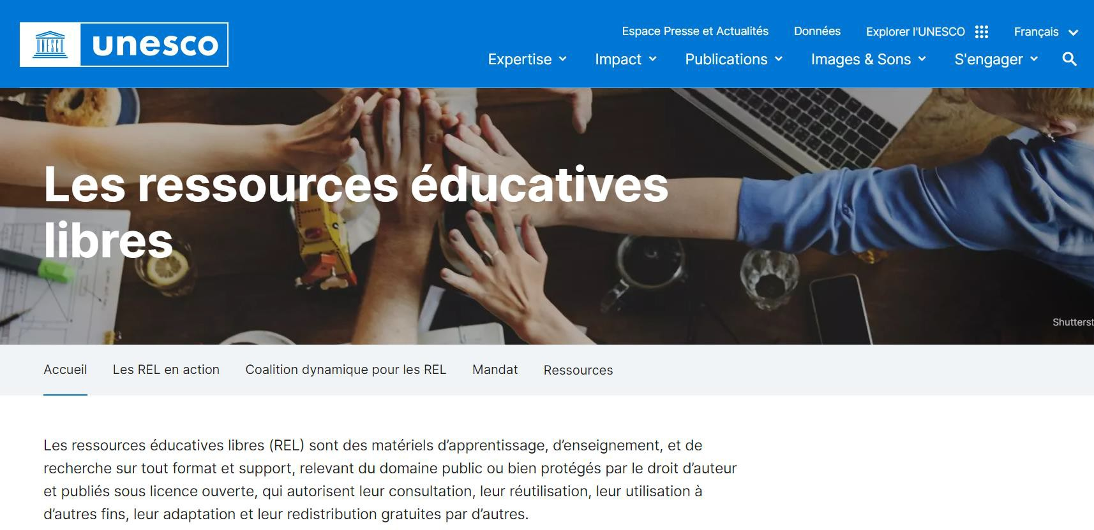

Slide 17


https://bneuf.auf.org/

Slide 18






Slide 19
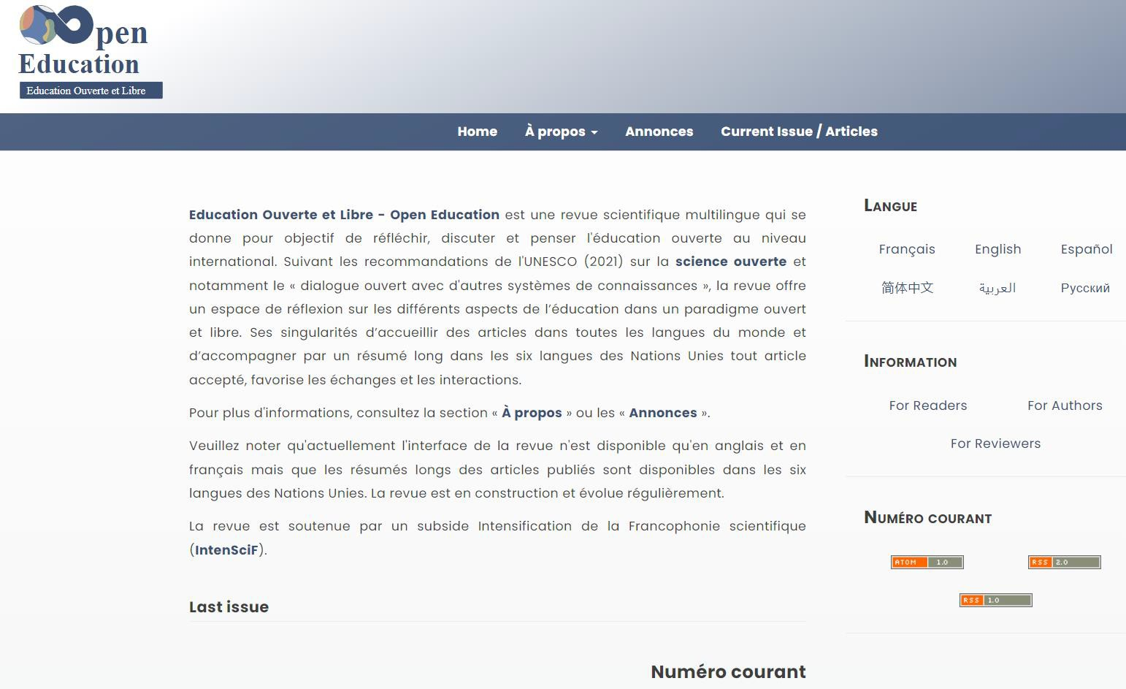


Slide 20

Join presentation to learn more:
Today, 3:45pm - 4:15pm
The Network of Open Organizations (NOO) - Strengthening and sustaining Open Education through Open Collaboration across Regions

Slide 21


Slide 22
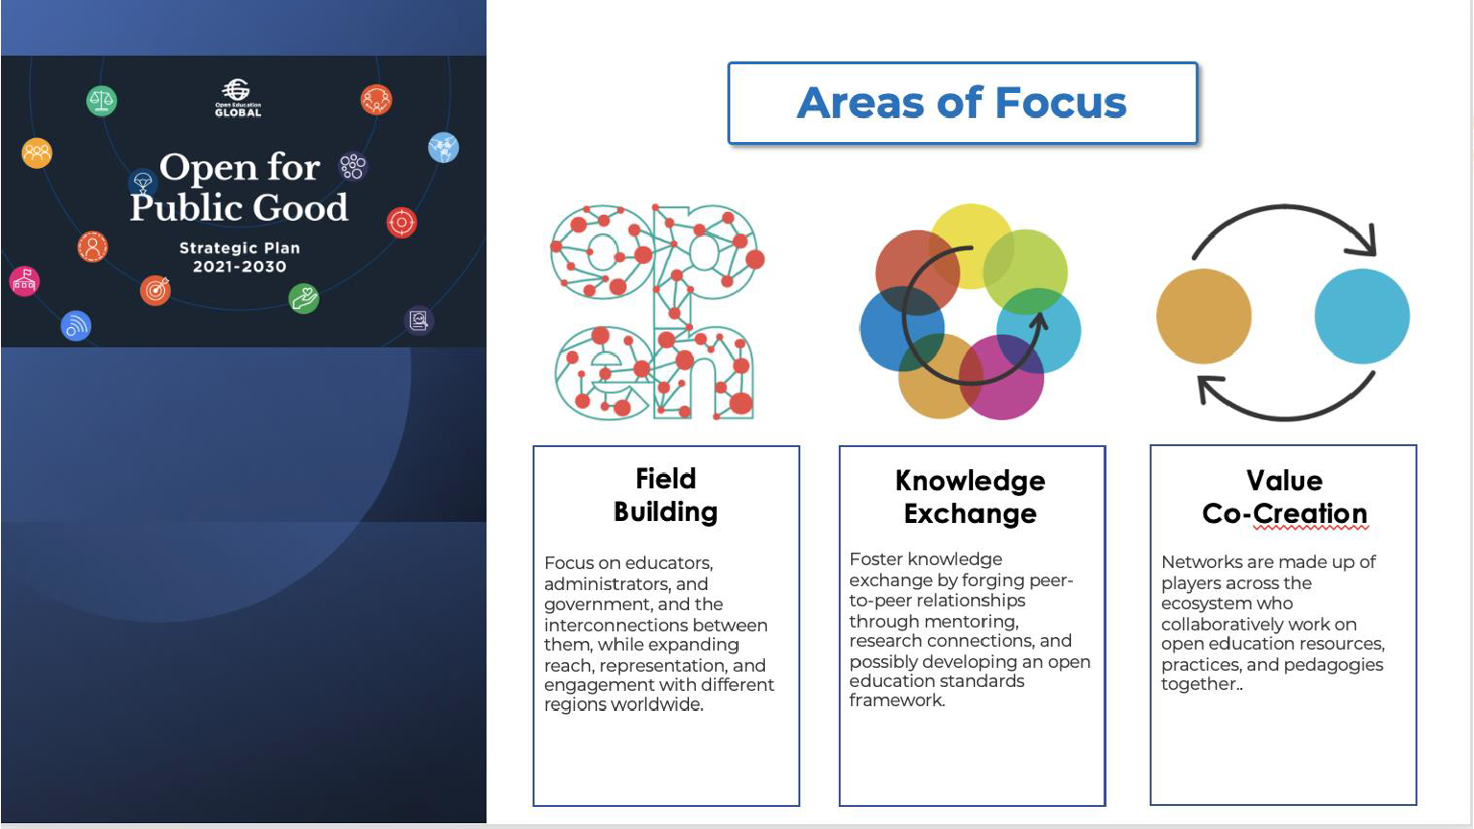

Slide 23


Slide 24

11/06/2024
OER-conference Tübingen
Conclusions:
German OER: you participate to a World movement
You are not alone
This is a long way, that is getting stronger
We need you!
Let’s build on the existing OER, let’s also build new solutions to teach and learn anywhere, to make learning as exciting and addictive to the new generation and all Open Education Lovers
Back to the future!
Perrine de Coëtlogon
President of the Board
Open Education Global

